Slide 1

Welcome to Oak Class!
Parent Information Session
September 2026

Slide 2
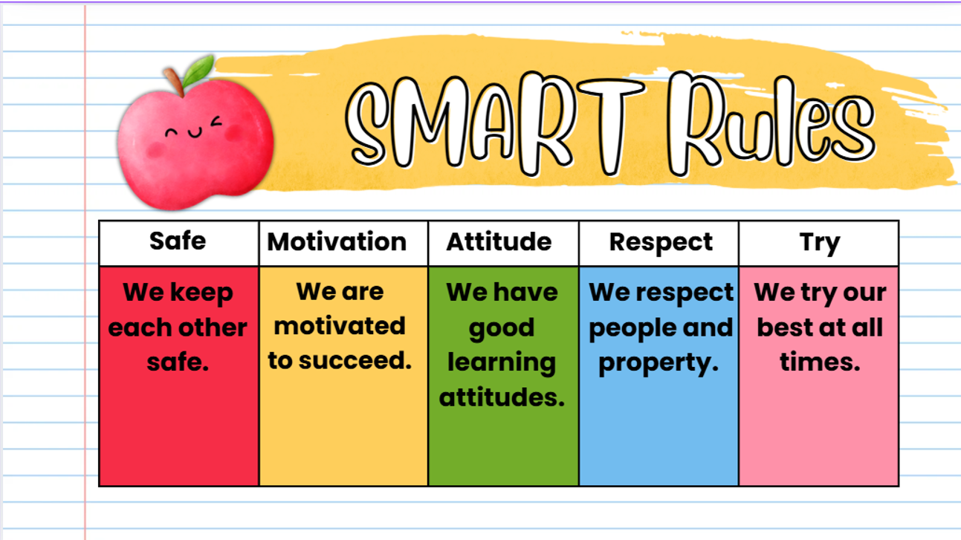

Expectations
We have discussed and come up with our class rules to help us be safe, learn and get along with each other
We also follow our school rules and encourage ‘SMART’ behaviour.

Slide 3
Behaviour & Rewards
Building relationships, supporting each other, class community
Behaviour: House points, kindness stars, restorative conversations
Rewards: Headteacher’s Award and Learning Behaviour Award weekly

Slide 4
Topics
Autumn 1: Bucklesham Bake Off
Autumn 2: Pole to Pole
Spring 1: Dinosaurs
Spring 2: Contrasting Cultures – Super Me, Super You
Summer 1: Map it Out
Summer 2: Habitats

Slide 5
Homework
Homework is given out half termly and will be tied in with our learning in school. This will be given out at the start of a new half term and due in on the last week.
Children will always have a variety of activities to choose from, covering different aspects of the curriculum.
Children can hand in their homework via Dojo or in their homework/spelling book.
We encourage children to aim for 10 points.
We also offer a homework club on a Monday after school 3:30 - 4:10pm.

Slide 6
Spellings
Learning spellings will be part of your child’s homework. They are sent out weekly with the Guided Reading books on a Friday. Year 1s are assessed through half termly phonics assessments. Year 2s are assessed half termly up to Christmas and then weekly spelling tests (on Fridays) after Christmas.
There is no set way to learn/practise spellings. Suggestions include: repeated writing; look, cover, write, check; online games

Slide 7
Reading
Please write in your child’s reading record whenever they read at home and if they read other books/texts outside of school also.
Children will be listened to as often as possible at school. Diaries are checked once a week for the reading awards.
There are 3 books that will come home with your child: Guided Reading book, reading book, library book

Slide 8
Class Dojo
Class story - where you can find the most up to date information about what we’re up to in class! But please also read the main weekly school newsletter.
Portfolios - upload any learning from home for us to share in class.
Messages - I aim to check this at lunchtime and if not then after school
If you have an urgent message please contact our office.

Slide 9
PE
This half term our PE days are Mondays and Fridays
Friday PE is with our sports coach Mo so will be outside on the field – unless it is pouring with rain!
We encourage the children to be as independent as possible with changing, exceptions are made for laces and top buttons
Earrings will be covered with earring tape

Slide 10
Safeguarding
Safeguarding is everyone’s duty and if you see anything that concerns you please speak to myself, Mrs Cordle or Miss Rudge.

Slide 11
Year 1 Phonics Screening
Statutory assessment, week commencing Monday 14th June 2027
Children are assessed on their ability to blend and read real words and ‘alien’ words
The pass mark for the last few years has been 32/40, although last year it was 31/40

Slide 12
Year 2 End of Year Assessments
We use the SATs papers to inform teacher assessment
No longer statutory, which means we can deliver them more flexibly
Plenty of practise throughout the year
6 papers in total: 2 reading papers, 2 maths papers, 1 spelling paper, 1 grammar paper

Slide 13
How can you support your child?
Reading to them, listening to them reading and homework. Visiting the local library and letting them choose books to borrow.
Keeping in regular contact!
Discussing their topic with them and exposing them to new vocabulary where and when you can.
Calm routines – journey to school, saying goodbye, bedtime.

