Slide 1

Welcome to Ash Class!
Parent Information Session
September 2025

Slide 2

Expectations
As a class, we have come up with our own agreement to ensure we have a classroom where we feel happy, excited to learn and safe – the Three R’s… Respect yourself, respect others, respect our learning environment.
We also follow our school rules and encourage independence through the 5 Bs and our learning behaviours.
In KS2 we encourage children to take responsibility for their learning, for example, this could be writing in their own reading in their diaries or making time to practice times tables. They are also expected to be responsible for their own belongings and for keeping our classroom environment neat and tidy.
We are all accountable for our behaviour in Ash class and although we may not be friends with everyone, we can be friendly and respectful of each other.
Notes:
Independence – writing own reading carrying own bag
Learning journey
Friendships
Talk about fidget toys
Low level behaviour

Slide 3
Behaviour & Rewards
This term has seen the introduction of our positive behaviour system. All children begin on the green and may move onto the rainbow and earn house points by displaying good learning behaviours. For exceptional effort, work or behaviour, children maybe moved to the star where they are awarded 10 house points.
Each week, children from the class will be nominated for the learning behaviour of the week award and headteachers award.
Reading underpins all of our learning. Regular reading is rewarded with bronze, silver, gold and platinum awards. To earn these, children need to record at least four reads a week in their diaries over ten weeks.
Times table rockstar certificates can be earned through regular engagement with the app.

Slide 4
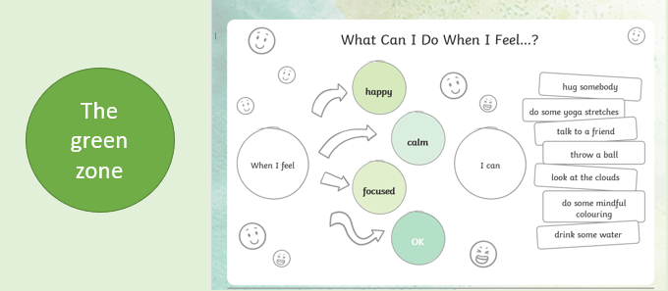
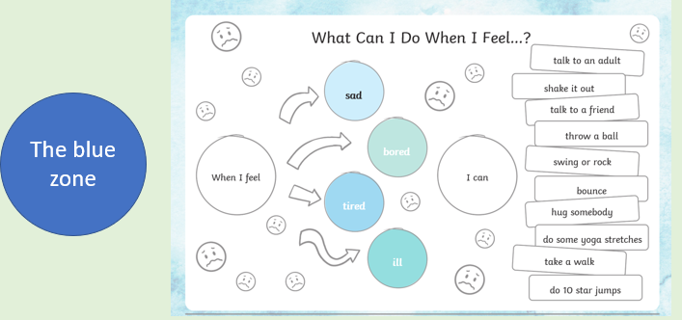
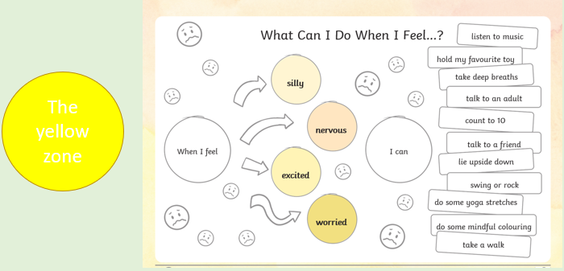
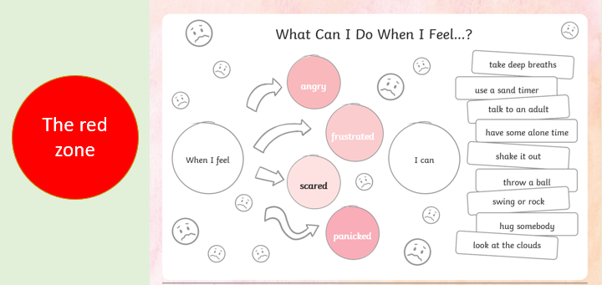
Daily wellbeing check in
Children are encouraged to check in on our wellbeing board in the morning and after lunch. This helps assess if everyone is ready to learn and provides an opportunity for them to express feelings and find strategies to help them regulate.

Slide 5
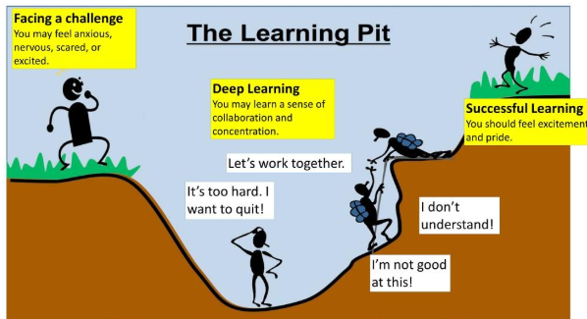
Growth mindset
The jump to KS2 can feel like a big change and it is important to remember that every mistake provides us with an opportunity to learn and grow.
We talk about the learning space as the place between not knowing and knowing. The journey through the learning space can feel uncomfortable and frustrating and it is easy to want to give up or think we are not very good at something at this point. Using our growth mindset to encourage positive self talk can help us navigate this tricky place.

Slide 6
Homework
Homework is given out half termly. There are a selection of challenges that will be given out towards the start of a new half term and due in on the last week. Homework can be handed via Dojo portfolio or in the homework book and can be approached it in any way.
There are also weekly tasks – TTRS, CUSP spelling sheet and daily reading. These are set on a Friday. Books should come back to school every Wednesday so that I can mark and return them by Friday.
Each task, including weekly tasks are worth 2 points. We encourage children to aim for 10 points each half term. Homework forms part of our home/school agreement and children are expected to complete this regularly.
Homework club on a Monday after school, 3:30 - 4:10pm.
Notes:
Children will always have a variety of activities to choose from, covering different aspects of the curriculum to apply to all interests.Children will always have a variety of activities to choose from, covering different aspects of the curriculum to apply to all interests.

Slide 7
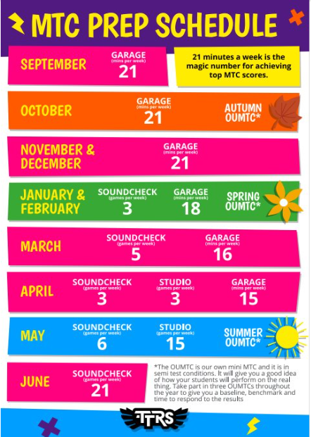
Times tables
Year 4 will have the national Multiplication table check (MTC) in the Spring term.
We aim to build their confidence and fluency in their times table throughout the year (two years for year 3) but also ensure conceptual understanding of them through explicit teaching.
Times table are more than just passing a test – they underpin maths skills and are invaluable as children encounter bigger numbers further up the school.
Please encourage regular use of TT rockstars. Short burst of a few minutes at a time are the perfect way to build recall and fluency.
🎸 Game Types on Times Tables Rock Stars 👨‍🎤 – YouTube This video explains the different games types and what they are most effective for. Gig can only be done once a month – it would be preferable to do this in school.

Slide 8
How can you support your child?
Regular reading and times tables practice at home.
Writing – build their writing stamina at home with regular small writing activities such as writing the shopping list.
Keeping in regular contact! I am here to support you and your child on their journey through lower KS2. Please feel free to chat at the end of the day, once all the children have been handed over to parents, or anytime on dojo.

Slide 9
Class Dojo
Class story… where you can find information about what we’re up to in class
Portfolios… where you can post pictures of homework
Messages… where you can contact me at any time. I check this throughout the day but there may be a delay in replying during teaching time.

