Slide 1

Welcome to Oak Class!
Parent Information Session
September 2025

Slide 2

Expectations
As a class, we have come up with our own agreement to ensure we have a classroom where we feel happy, excited and safe
We also follow our school rules and encourage independence through the 5 Bs

Slide 3
Behaviour & Rewards
Green – morning and afternoons
Rainbow – house point
Star – star house point (worth 10 hp)
  WOW tickets
Learning behaviour award
Headteachers award
Behaviour book

Slide 4
Topic
Autumn 1: Growth
Autumn 2: Our Wonderful World
Spring 1: Animals and People
Spring 2: Africa
Summer 1: Environment
Summer 2: Our Local Community

Slide 5
Homework
Homework is given out half termly and will be tied in with our topic. This will be given out towards the start of a new half term and due in on the last week.
Children will always have a variety of activities to choose from, covering different aspects of the curriculum to apply to all interests.
Children can hand in their homework via Dojo portfolio or in person and can approach it in any way.
We encourage children to aim for 10 points.
We also offer homework club on a Monday after school, 3:30 - 4:10pm.

Slide 6
Spellings
Learning spellings is also part of your child’s homework. Spellings will be sent out weekly with your child’s Guided Reading book. Year 1s will be assessed through our half termly phonics assessments. Year 2s will be assessed half termly initially, but then move on to weekly spelling tests in January.
Children can practice their spellings in their spelling book, on loose paper or in their homework book, whatever works best for them.

Slide 7
Reading
Please write in your child’s reading record whenever they read at home and if they read other books/texts outside of school also – initials are fine
Children will be listened to as frequently as possible by an adult in school. This will also be noted in your child’s reading record.
Reading Challenge

Slide 8
How can you support your child?
Practicing spelling, reading and times tables.
Keeping in regular contact!
We recommend the CGP revision books for maths, reading and English.

Slide 9
Year 1 Phonics Screening
Week commencing 8th June 2026
Children are assessed on their ability to blend and read real words and ‘alien’ words
The pass mark for the last few years has been 32/40

Slide 10
SATS
SATs are no longer statutory, we use them to inform teacher assessment for end of year attainment
Papers will be delivered in June, exact days will be confirmed nearer the time
We can be flexible about how and when we administer them
There will be plenty of practise throughout the year
There are 2 Reading papers, 2 Maths papers and 2 SPaG papers (1 spelling and 1 grammar)
The totals for each pair of papers are added together to give a scaled score

Slide 11
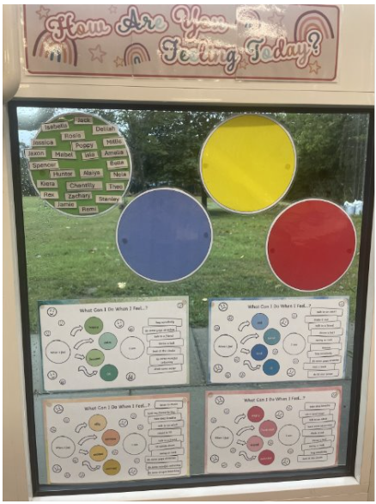
Wellbeing

